Slide 1





OUR WORKING PRINCIPLE · DEVELOPMENT MODEL + OPERATING MODEL
Everything as Code — One Source of Truth
From idea to running data product
DEVELOPMENT MODEL · GITHUB SYSTEM OF RECORD
Project
Issue
Branch
App-code PR
Q preview
Review
main
Secrets & live telemetry stay outside Git
OPERATING MODEL · FROM MAIN TO A RUNNING SYSTEM
selected PR → Actions / GHCR → Q via Portainer API
main → Actions → GHCR : latest
production ← main config via Portainer · GHCR : latest via Docker
RUNNING DATA PRODUCT
Terraform → Q infra
MongoDB Atlas · Bronze
ETL
Supabase Postgres · Silver
Tunnel → edge
Plan · review · provision · package · deploy · operate

Slide 2
LIGHTWEIGHT PROJECT MANAGEMENT · ENGINEERING CONTROL
From idea to reviewed change
Public GitHub Project · Kanban + Roadmap
AIRLINE PROJECT
Kanban Roadmap
TRACE
Board-to-change traceability
Ideas 2
Todo 2
In Progress 1
Done 3
Redshift history
Isolate Q Mongo
Cloudflare → IaC
#15 fallback source
Issue #15
PR #20
Done
assignment · Todo → In Progress → Done · linked, merged to main
Metrics + alerts
Promote digest
Cloudflare Tunnel
Q environment
REVIEW
Second-person review is team policy (ADR 012)
PR #9
changes
requested
approved
changes requested → corrected → approved → merged
Visible work → linked change → reviewed merge

Slide 3
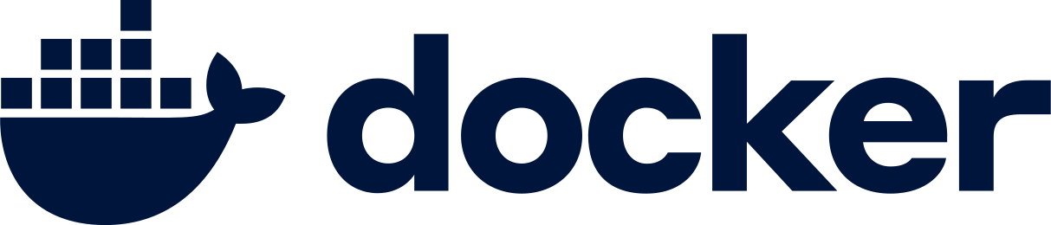
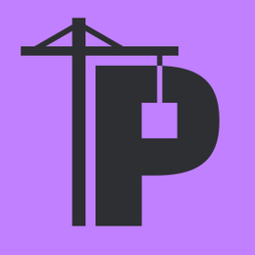

THE DELIVERY FLOW · CI · CD · GIT-DRIVEN OPS
Application-code PRs become running Q previews
CI build & publish container images
feature branch
PR · app paths
Actions build
GHCR : pr-N + sha-*
CD API-triggered Q deployment
pr-N image tag
Portainer API
Q Compose stacks
q_map1
⚠ Q MongoDB is shared with production
review the running Q system + approve → squash-merge → main build : latest + sha-*
GIT-DRIVEN OPS Portainer polls main configuration
GHCR : latest
Portainer Git polling
production stacks
map1
⚠ Rebuild after merge; no sequenced production deploy job
⚠ Workflow filters: selected application / Dockerfile / build-workflow paths — Compose, Portainer, docs & Terraform-only changes get no pre-merge Q preview
The VMs pull images;
they never build application code.

Slide 4

INFRASTRUCTURE OWNERSHIP · SECOPS
Code-defined boundaries reduce operational risk
PROVISION
RUN
EDGE
Terraform + AWS API
Portainer + Compose
Cloudflare Tunnel
Q VM · static IP · firewall
Pull GHCR images · configure · restart · observe
Outbound-only ingress · API / dashboard rules
Terraform owns Q only. Production VM predates this IaC boundary.
A VM only pulls images; builds live in CI, never on a host.
Removes inbound HTTP/HTTPS + VM-side TLS. Routing is remote API state.
Terraform —AWS API→ Q Lightsail · manual trust bootstrap → Portainer / Compose · containers —outbound tunnel→ Cloudflare edge → users
SECURITY POSTURE
⚠ KNOWN GAPS
No secrets in Git or Lightsail user data
Production VM + Cloudflare routing outside IaC
Atlas permits all source IPs (0.0.0.0/0)
Zero inbound web ports (SSH remains)
Scoped image-build permissions
AWS CLI = authenticated inspection capability, not a deployment engine

Slide 5
DAY-TWO OPERATIONS · HONEST LIMITS
Operational proof today, hardening path tomorrow
OPERATES TODAY
NEXT HARDENING STEPS
✓
ETL heartbeat + API health checks
1
Unit, lint, image-scan & SBOM gates in CI
✓
Restart policies + local container logs
2
Promote the tested image digest after merge
✓
Independent Bronze / Silver lifecycles
3
Central metrics, alerts & log aggregation
✓
Separate production / Q compute
4
Isolate Q MongoDB; Cloudflare + prod under IaC
gaps return to the visible GitHub Project ↩
Architectural judgment: Docker Compose is sufficient at this scale — Kubernetes would add an operations platform before the project needs one.
Everything as Code — One Source of Truth.

Slide 6
WHY THIS SEGMENT BELONGS IN THE DEFENSE
Course curriculum, proven by project evidence
SQL & MongoDB
MongoDB Atlas Bronze + Supabase Postgres Silver
Sprint 3
ETL & AWS Cloud Practitioner
Managed data services + AWS Lightsail compute
Sprint 5
DevOps / isolation
Docker · FastAPI health endpoints · env separation · API security
Sprint 7
CI/CD
GitHub Actions · GHCR · PR previews · release flow
Sprint 8
Monitoring & Terraform
Health checks · restart/logging policy · Terraform-managed Q infra
Sprint 9
⚠ Shown honestly: Kubernetes · Prometheus · Grafana are course topics but not implemented here — stated plainly, not hidden behind a technology logo wall.

